Slide 1


Software Defined Trends
Determining how virtualization is enabling more efficient and reliable digital substation operations
Sander Jansen l Alliander System operations l 21 March 2023
Notes:
Time total: 45 minutes
Presentation: 30 minutes
Q&A: 15 minutes

Slide 2
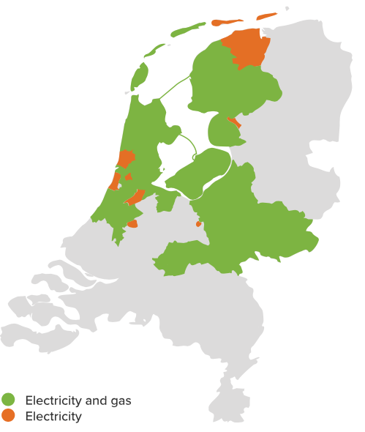
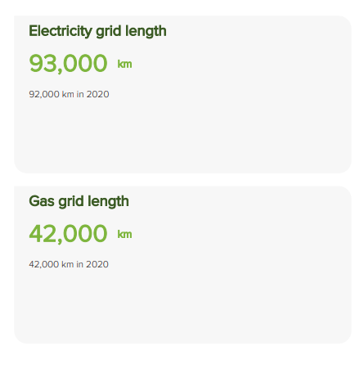


About Alliander and me
Ing Sander Jansen
Product Owner virtual substations
Background in
Data architecture
Electrical engineering
Notes:
Annual report 2021 (alliander.com)

Slide 3
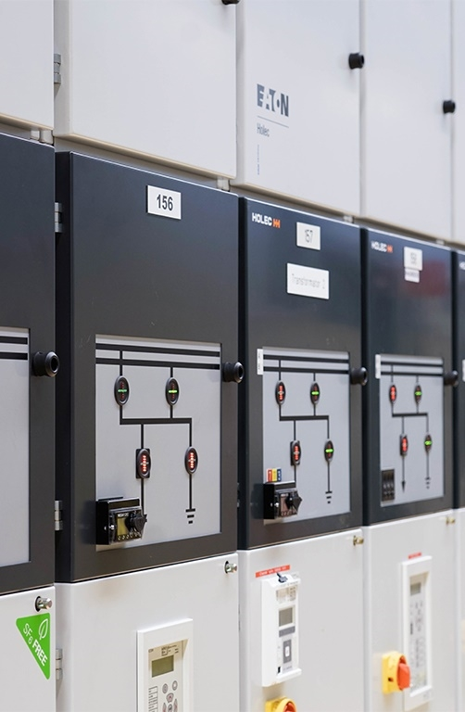
The challenge in substation automation
No separation between hardware and software
61850 engineering process varies
61850 configuration tools are Desktop oriented
Limited choice in IED vendor agnostic SCL tools
Vendor lock-in on hardware and software
Limited flexibility (e.g., limited SCL automation)
No economy of scale with order sectors
Complexity with a lot of devices

Slide 4
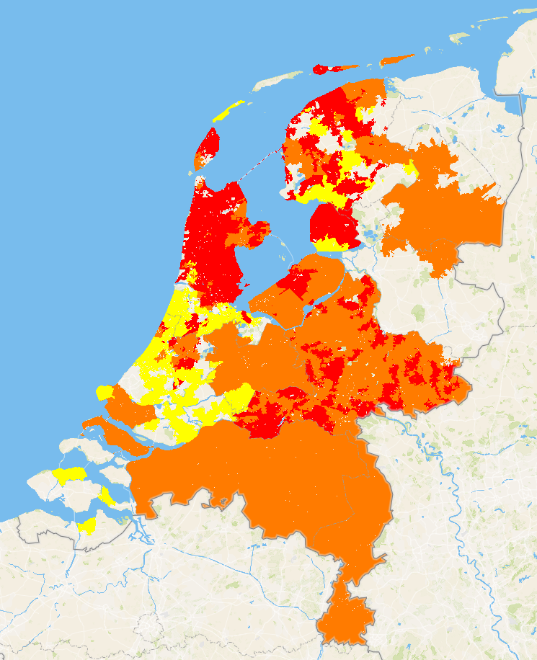
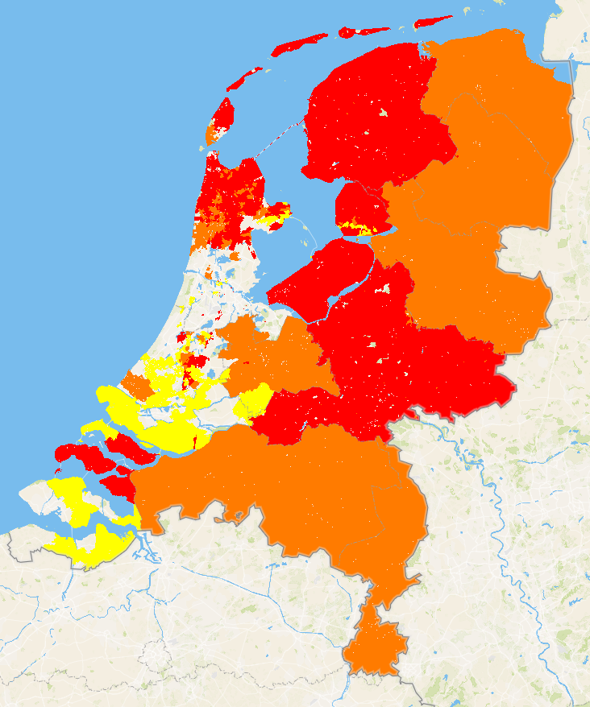
Change ahead
Hard to find technical staff: Need for efficiency
More flexibility needed to coop with changes in the system
Increasing importance of 61850 to support multivendor / interchangeability
Classic consumption limitations
Grid feed-in limitations
Capaciteitskaart elektriciteitsnet (netbeheernederland.nl)

Slide 5
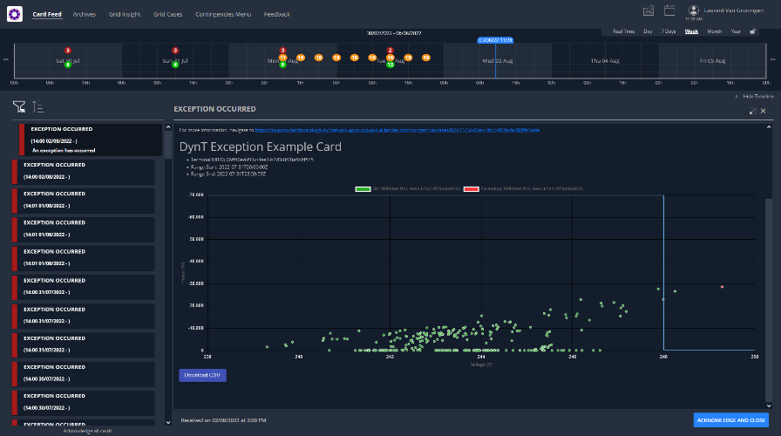


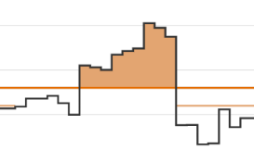


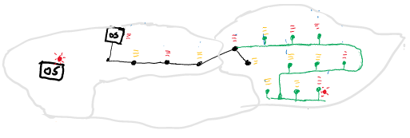

Alliander system operations architecture
Process/progress assistance
1. Creating integral view
2. Determine problems and solutions
3. Apply solutions (agents)
& verification
Short Term Forecaster
State
Estimator
Dynamic
Safety & Contingency
Assessment
Solution Fulfillment Manager
Grid solution agents
Market solution agents
Customer solution agents
Support
Virtual Grid
Autonomous grid management

Slide 6
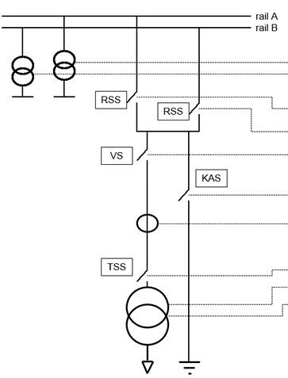



LF Energy open source substation architecture
Merging unit / IO / Digital instrument transformer
IEC 61869-13
IEC 61869-9
Substation functions e.g protection
Gateway
61850
Central systems
61850 processbus
61850 stationbus
61850 SCL
Notes:
Why virtualisation?
Less hardware complexity
Take advantages of generic computing power (economy of scale)
Less vendor dependent
More room for innovation

Slide 7
What is open source?
Open Source
is simply defined as a permissive IP license that enables shared investment
and leveraged development
According to Wikipedia:
Open source software (OSS) is a type of computer software in which source code is released under a license in which the copyright holder grants users the rights to study, change, and distribute the software to anyone and for any purpose. Open source software may be developed in a collaborative public manner.
Notes:
Why Open Source Talking Points - Google Presentaties
It is used everywhere,

Slide 8
Open source software is a market accelerant
Standardization on open technologies
Neutral environment for collaboration & cross-pollination
Innovation multiplier
Enables better interoperability
Minimizes fragmentation
Qualifies reference architectures
Lowers barriers to enter a new domain
Enables new business opportunities
Leads to better products
Allows shared cost of development

Slide 9
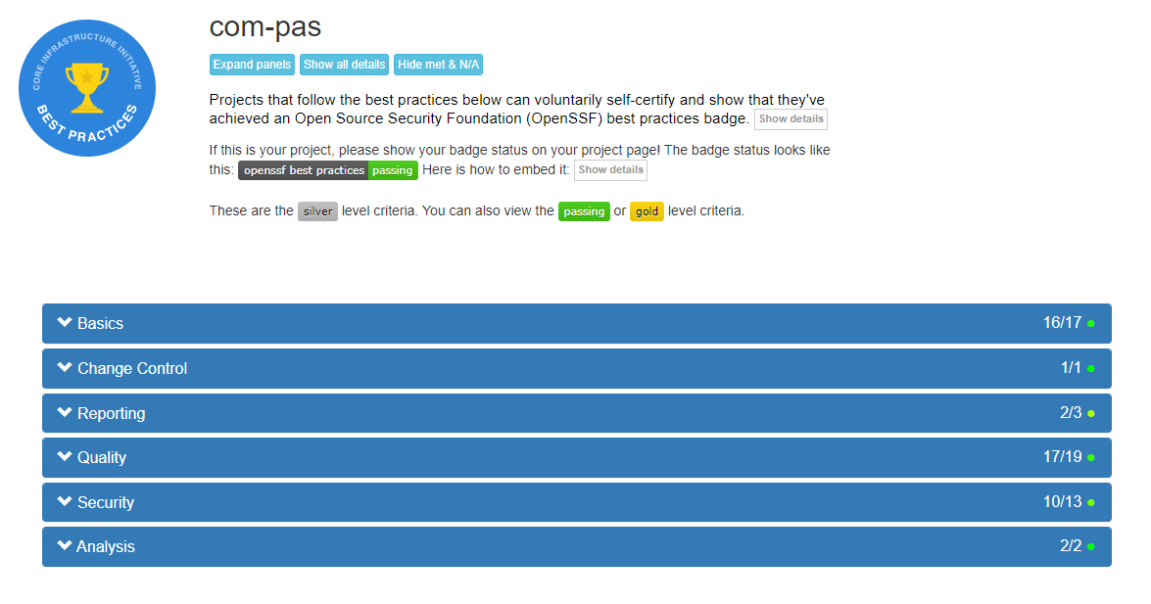
Open source & Security
Notes:
Follow best practises:
Code reviews
Static code analyses
Automatic get new updates (dependabot)
Don't share secrets e.g. passwords

Slide 10
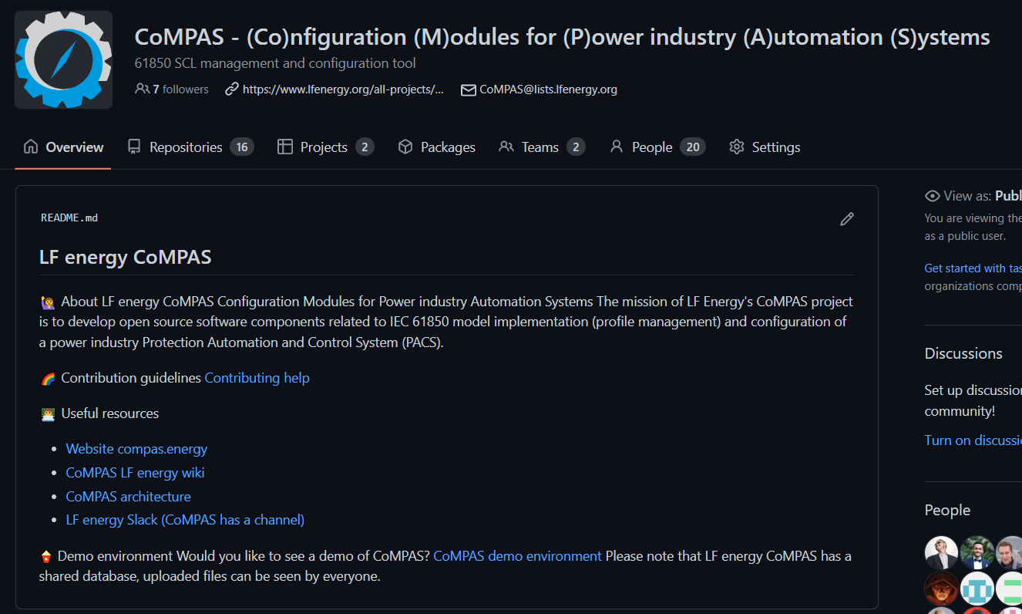

Open source in practice: LF Energy CoMPAS
IEC 61850 configuration editing
Open-source approach
Central SCL data management
Plug-in/flexible architecture
(private) cloud hosted
"Easy" to use
Notes:
Couple refinements together (9 persons)

Slide 11
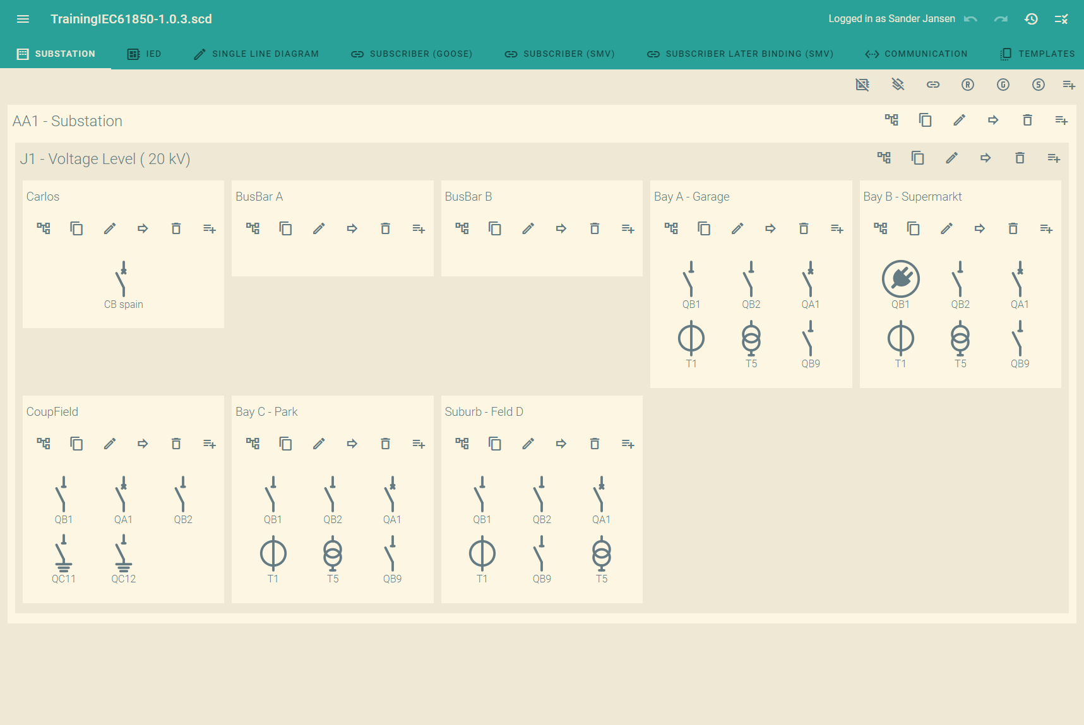
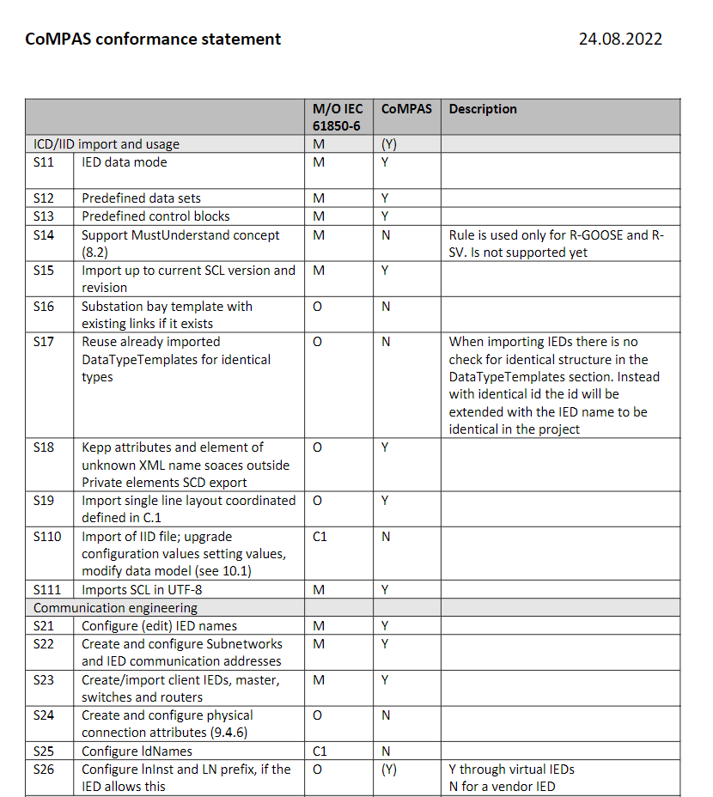
Current features
Current capabilities of LF Energy CoMPAS
Basic SCL editing
GOOSE/SV
Reporting
Partly 104 support (80-1)
Compare IED's/SCL files
SCL cleanup
Library for SCD generation process
IEC CIM to IEC 61850 conversion
Many more..

Slide 12
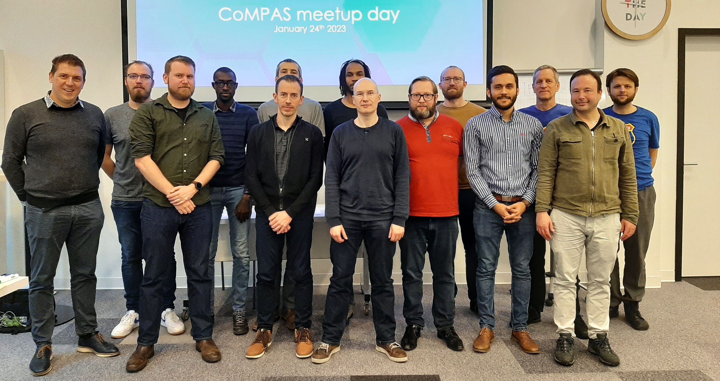






Current CoMPAS / OpenSCD community
A meetup in Frankfurt January 2023
You?

Slide 13
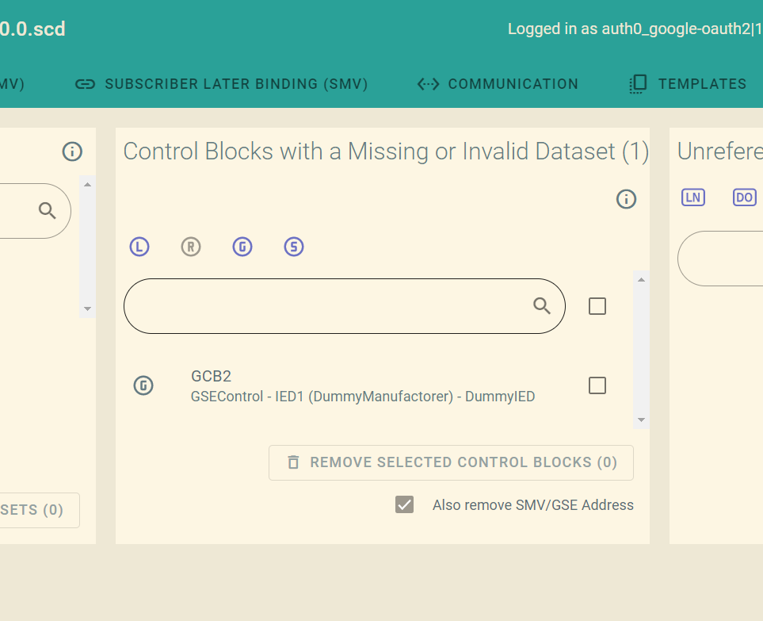
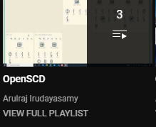
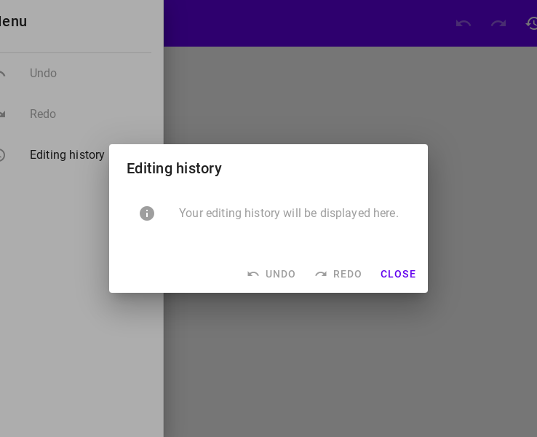
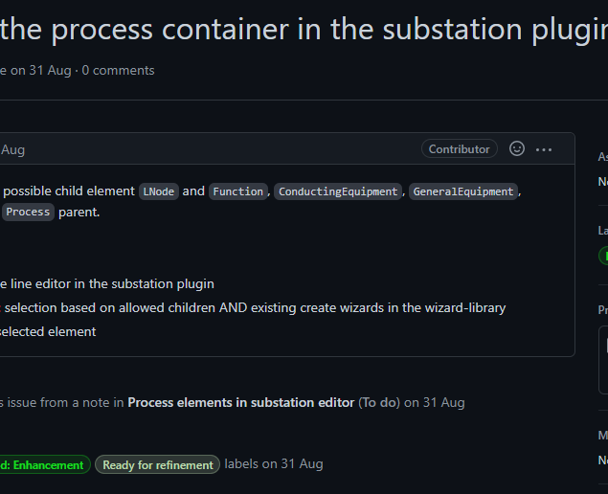
Contribution examples
Daniel: Cleanup tool
Arulraj: Youtube tutorial
Christian: OpenSCD-core
Jakob: Write issues

Slide 14
Everybody is welcome to contribute!
Bug reports / Fixes
Documentation
Feature requests
Test with vendor tools
Build your own plug-in
Code contributions

Slide 15






Find out more!
www.lfenergy.org
Demo.compas.energy

Slide 16
Summary
Virtualization leads to:
More flexibility
Less hardware complexity
Configuration is key
The open source concept can contribute by:
Shared investment
Low barrier for collaboration

Slide 17
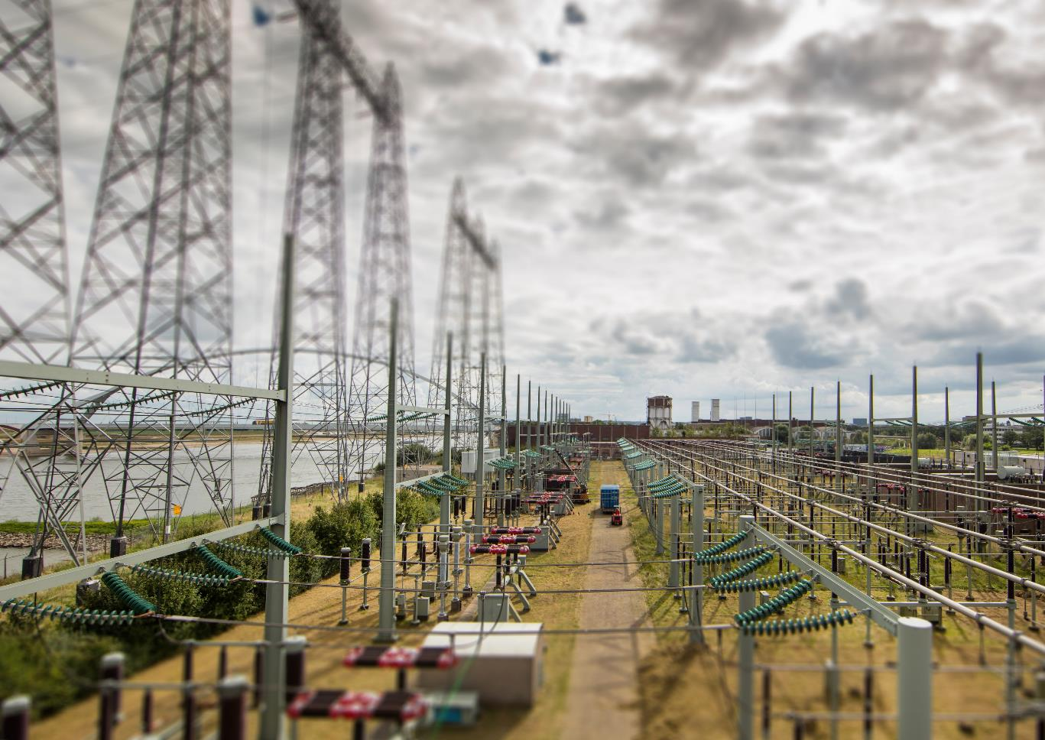

Questions?
To contact me:
Sander.jansen@alliander.com

